Slide 1

FED
WE
E
K
JavaScript Essentials
Browser Environment
Front End Development
Diploma in CSF
Year 1 (2021/22), Semester 2
6

Slide 2
Remote Learning Instructions
Step 1
Read the given slides
Details in slide 1-18
Step 2
Perform highlighted activities in Activities slide
Details in slide 19
Step 3
Complete and Submit Tasks given
Details in slide 20

Slide 3
Topics
1. Introduction to JavaScript
What is JavaScript
Adding JavaScript to a Page
The Anatomy of a Script
The Browser Objects
Events
2. Using JavaScript
Document Object Model

Slide 4
Learning Objectives
Basic Concept of JavaScript
Add inline JavaScript to a HTML document
Add JavaScript in an external file
Create JavaScript file with functions
Using objects and event handlers in JavaScript

Slide 5
What is JavaScript
JavaScript is a scripting language that adds interactivity and behaviors to web pages.
JS Can…
change HTML content
change HTML attribute values
change HTML styles
hide HTML elements
show HTML elements
etc

Slide 6
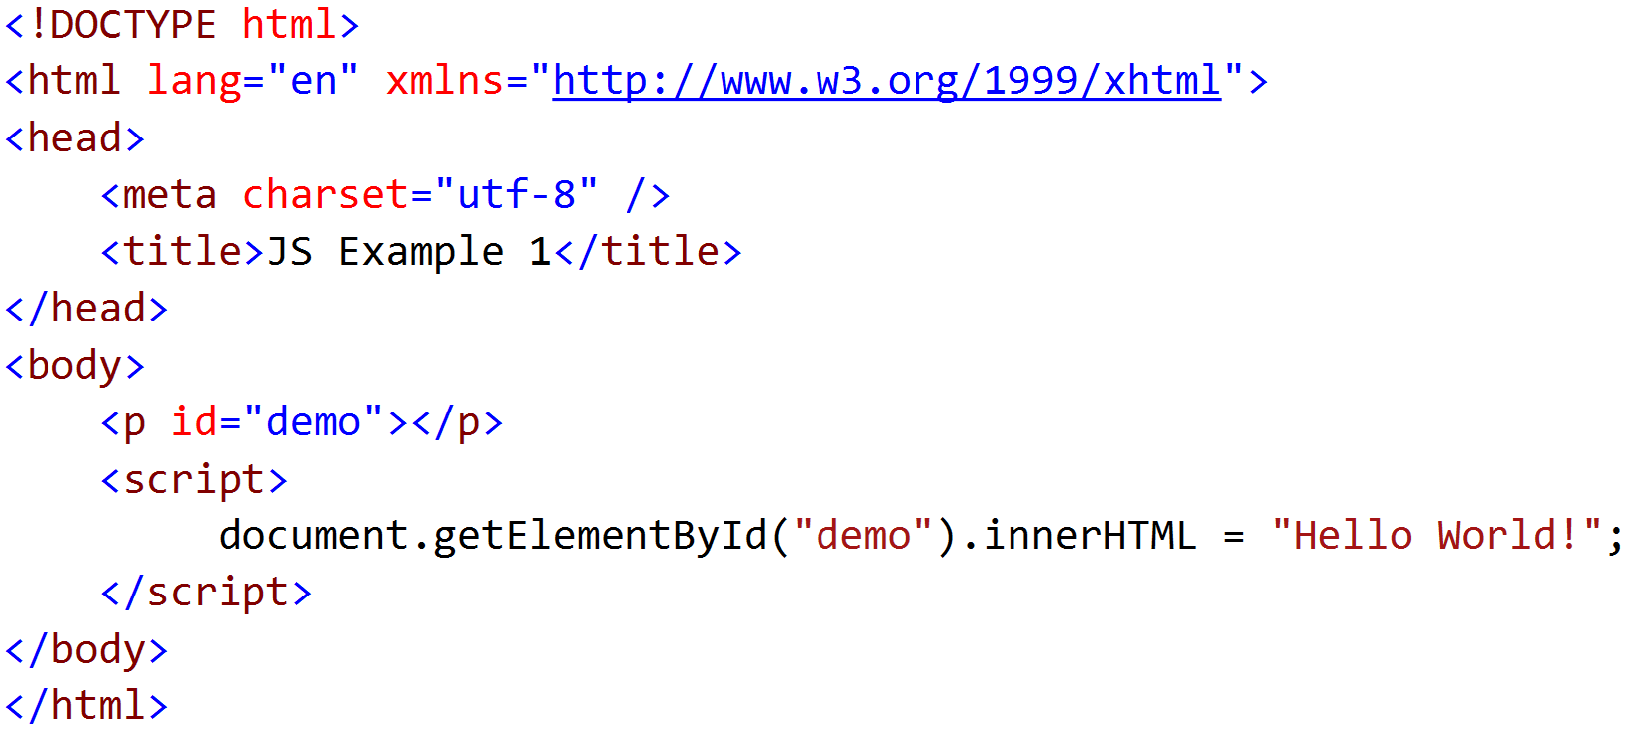
Add inline JavaScript to a HTML document
Add the code as the content of a script element
Eg 1

Slide 7
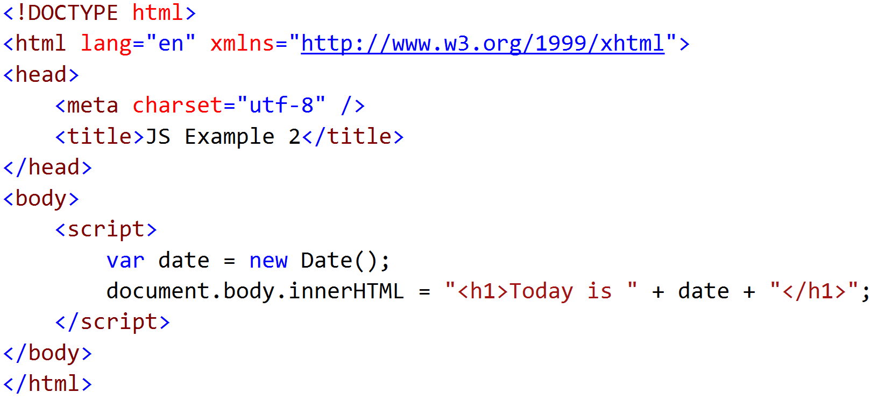
Add inline JavaScript to a HTML document
Eg 2

Slide 8
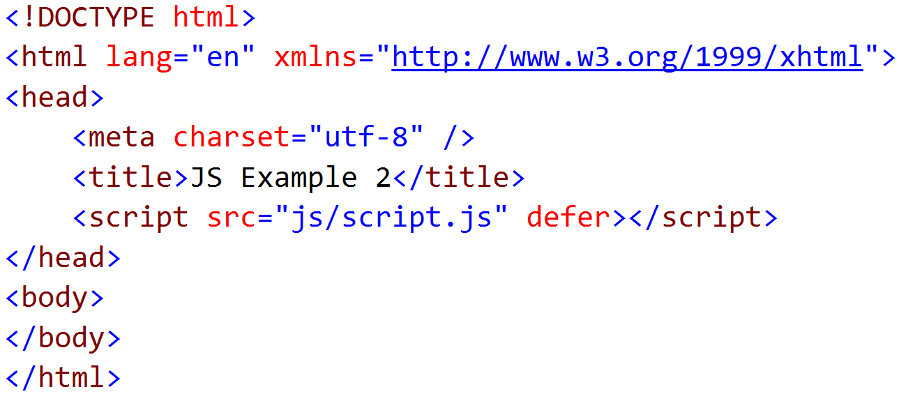
Add JavaScript in an external file
Type the script in an external file and save with .js extension (good practice to put in “js” folder)
Put the name of the script file in the src attribute of the script element
E.g.

Slide 9
Advantages of using External JavaScript
Separates HTML and code
Makes HTML and JavaScript easier to read and maintain
Cached JavaScript files can speed up page loads
Can be used in multiple HTML files easily

Slide 10
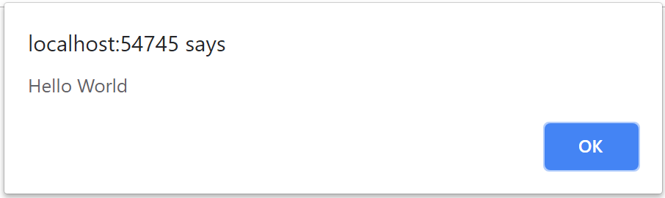
JavaScript Popup Boxes
Alert Box
An alert box is often used if you want to make sure information comes through to the user.
When an alert box pops up, the user will have to click "OK" to proceed.
E.g. alert("Hello World");

Slide 11
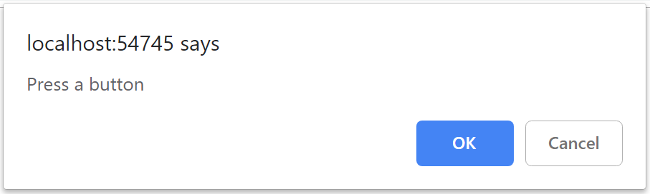
JavaScript Popup Boxes
Confirm Box
A confirm box is often used if you want the user to verify or accept something.
When a confirm box pops up, the user will have to click either "OK" or "Cancel" to proceed.
If the user clicks "OK", the box returns true. If the user clicks "Cancel", the box returns false.
E.g. confirm("Press a button");

Slide 12
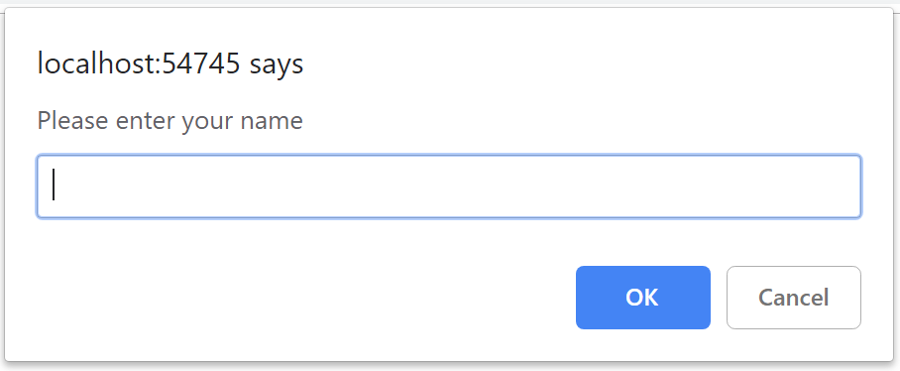
JavaScript Popup Boxes
Prompt Box
A prompt box is often used if you want the user to input a value before entering a page.
When a prompt box pops up, the user will have to click either "OK" or "Cancel" to proceed after entering an input value.
If the user clicks "OK" the box returns the input value. If the user clicks "Cancel" the box returns null.
E.g. prompt("Please enter your name");

Slide 13
JavaScript HTML DOM (ref: https://www.w3schools.com/js/js_htmldom.asp)
With the HTML DOM, JavaScript can access and change all the elements of an HTML document.
HTML DOM methods are actions you can perform (on HTML Elements).
HTML DOM properties are values (of HTML Elements) that you can set or change.
getElementById() Method
var myVar = document.getElementById("myElement");
places the object with the given Id (myElement) in the variable called myVar, hence allowing you to access that object directly
innerHTML Property
myVar.innerHTML = "Hello World";
Set the content of the HTML element to "Hello World"

Slide 14
Finding HTML Elements
document.getElementById(id)
Find an element by element id
document.getElementsByTagName(name)
Find elements by tag name
document.getElementsClassName(name)
Find elements by class name
document.querySelectorAll(selector)
Find elements by CSS selectors
document.forms[id]
Find elements by HTML Object Collections

Slide 15
Changing HTML Elements
element.innerHTML = new html content
Change the inner HTML of an element
e.g. to change the content of an element by id "p1" to "New text":
document.getElementById("p1").innerHTML = "New text";
element.attribute = new value
Change the attribute value of an HTML element
e.g. to change the value of the src attribute of an element by id "myImage" to "newImage.jpg":
document.getElementById("myImage").src = "newImage.jpg";
element.setAttribute(attribute, value)
Change the attribute value of an HTML element
element.style.property = new style
Change the style of an HTML of an element

Slide 16
Demo on how to access a Date field
HTML code:
<input type="date" id="myDate" min="">
<p>Click the button to see the date selected</p>
<button onclick="myFunction()">Click Me</button>
<p id="demo"></p>
JavaScript code:
// Setting minimum date for Date entry
var today = new Date();
var dd = today.getDate();
var mm = today.getMonth() + 1; //January is 0!
var yyyy = today.getFullYear();
if (dd < 10) {
dd = "0" + dd;
}
if (mm < 10) {
mm = "0" + mm;
}
var sToday = yyyy + "-" + mm + "-" + dd;
document.getElementById("myDate").setAttribute("min", sToday);
function myFunction() {
var x = document.getElementById("myDate").value;
document.getElementById("demo").innerHTML = x;
}

Slide 17
Javascript Essentials
Video on ‘Display Greeting Message’ (reference for worksheet)
Tasks | Notes (reference for worksheet)
Calculate BMI | Given bmiCalculator.html with partial filled code. Code bmiScript.js reference to bmiCalculator.html Video - https://www.youtube.com/watch?v=waBTdtNlsm4
JC Entry Cut Off | Given jcEntryPoints.html with partial filled code. Code jcEntryScript.js reference to jcEntryPoints.html Video - https://www.youtube.com/watch?v=E7lhNyG1wE0
Calculate Pizza Price | Challenge: Try all by yourself

Slide 18

Reference
Learning Web Design
A Beginner’s Guide to HTML, CSS, JavaScript and Web Graphics
Jennifer Niederst Robbins
Chapters 21 & 22
https://ebookcentral.proquest.com/lib/np/detail.action?docID=5412749&query=Learning+Web+Design

Slide 19
Activities
Read the following chapters from the textbook as reference materials.
Chapter 21 – Introduction to Javascript
Chapter 22 – Using Javascript
(Optional) Watch the video clips from JavaScript Essential Training from https://www.linkedin.com/learning/javascript-essential-training-3/welcome?u=42538748
You need to sign in with your email address to view the full video.

Slide 20
Tasks
Complete Week 6 Practical.
Download Week 6 Practical in MEL – “FED 2021-10 Week 6 Worksheet.pdf”
Deadline end of week 6
Submit the completed practical files in MEL.
Zipped the source files
Name the zipped file in following format:-
FED-Week06-SXXXXXXXX (where SXXXXXXXX is your student id)
Submit the zipped file in the weekly folder’s submission link in MEL
Also, submit the zipped file into FED network folder (https:///ictspace.ict.np.edu.sg/FED) under your studentID. This is for backup purpose only. Main submission is still in MEL.
If you have any questions please communicate with your tutor via Microsoft Teams.

Slide 21
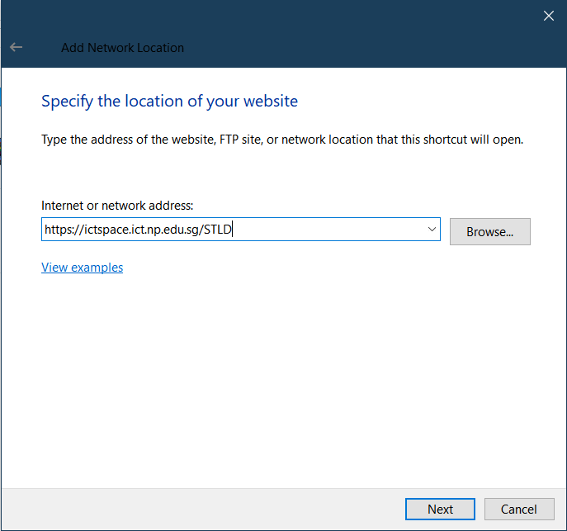
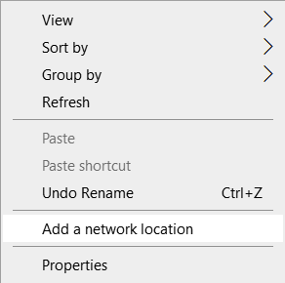
Appendix
Mapped to FED network folder
For Win Users
Right click on a blank space in your Windows Explorer
Select ‘Add a network location’
3. Enter https://ictspace.ict.np.edu.sg/(your assigned module)
4. Press ‘Next’

Slide 22
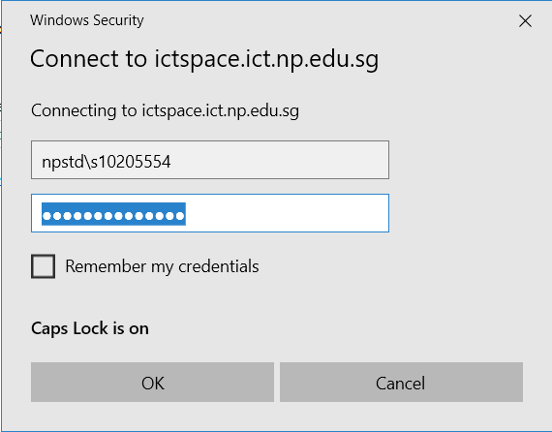
Appendix (Cont)
10123453
4. Login using npstd\s(your student ID number without the last alphabet)
5. Enter your NP student account password

Slide 23
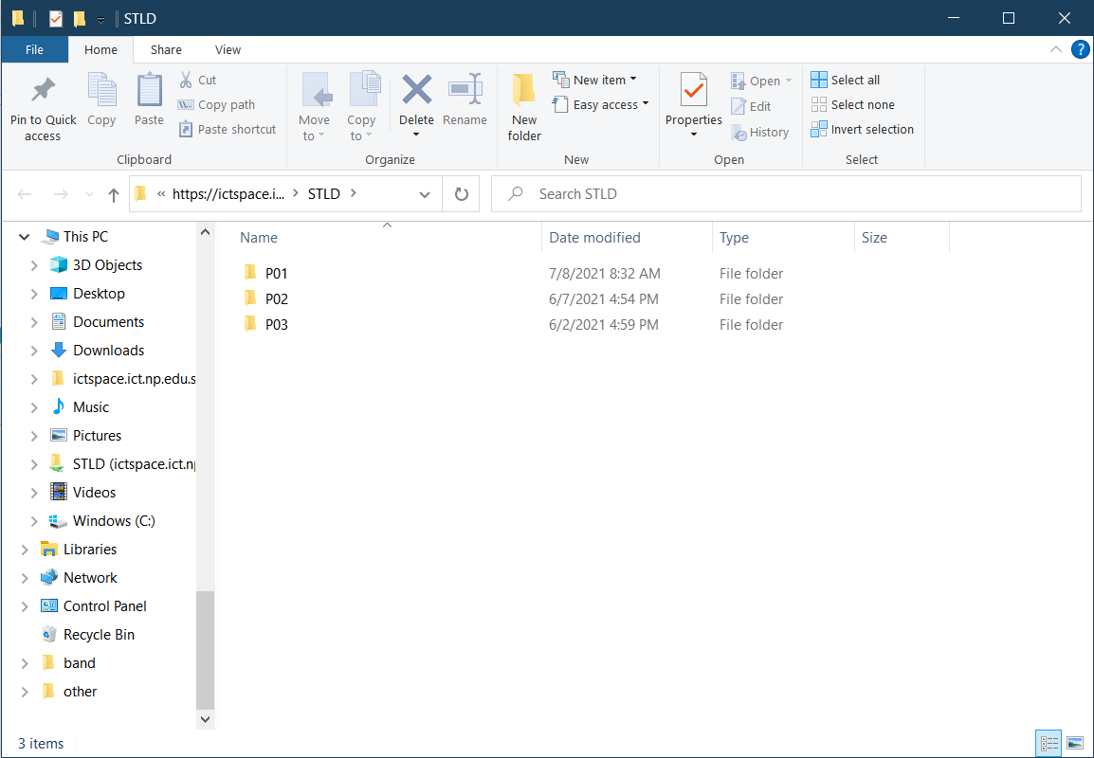
Appendix (Cont)
You should be able to see your class folder as shown in the example below.

